Slide 1

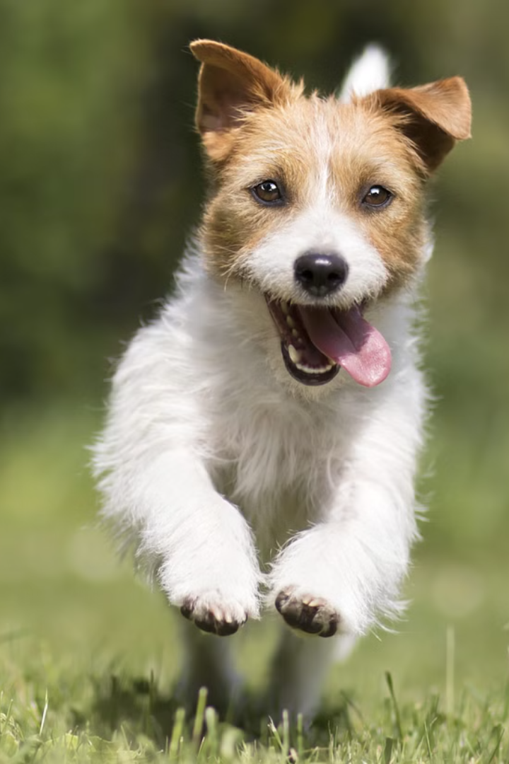
Introduction to BowWow
BowWow is a groundbreaking website that connects stray animals with nearby shelters, rescues, and compassionate individuals who can offer them a safe haven. By uploading photos of animals in need, users can quickly locate the closest resources to provide care and find loving forever homes.

Slide 2
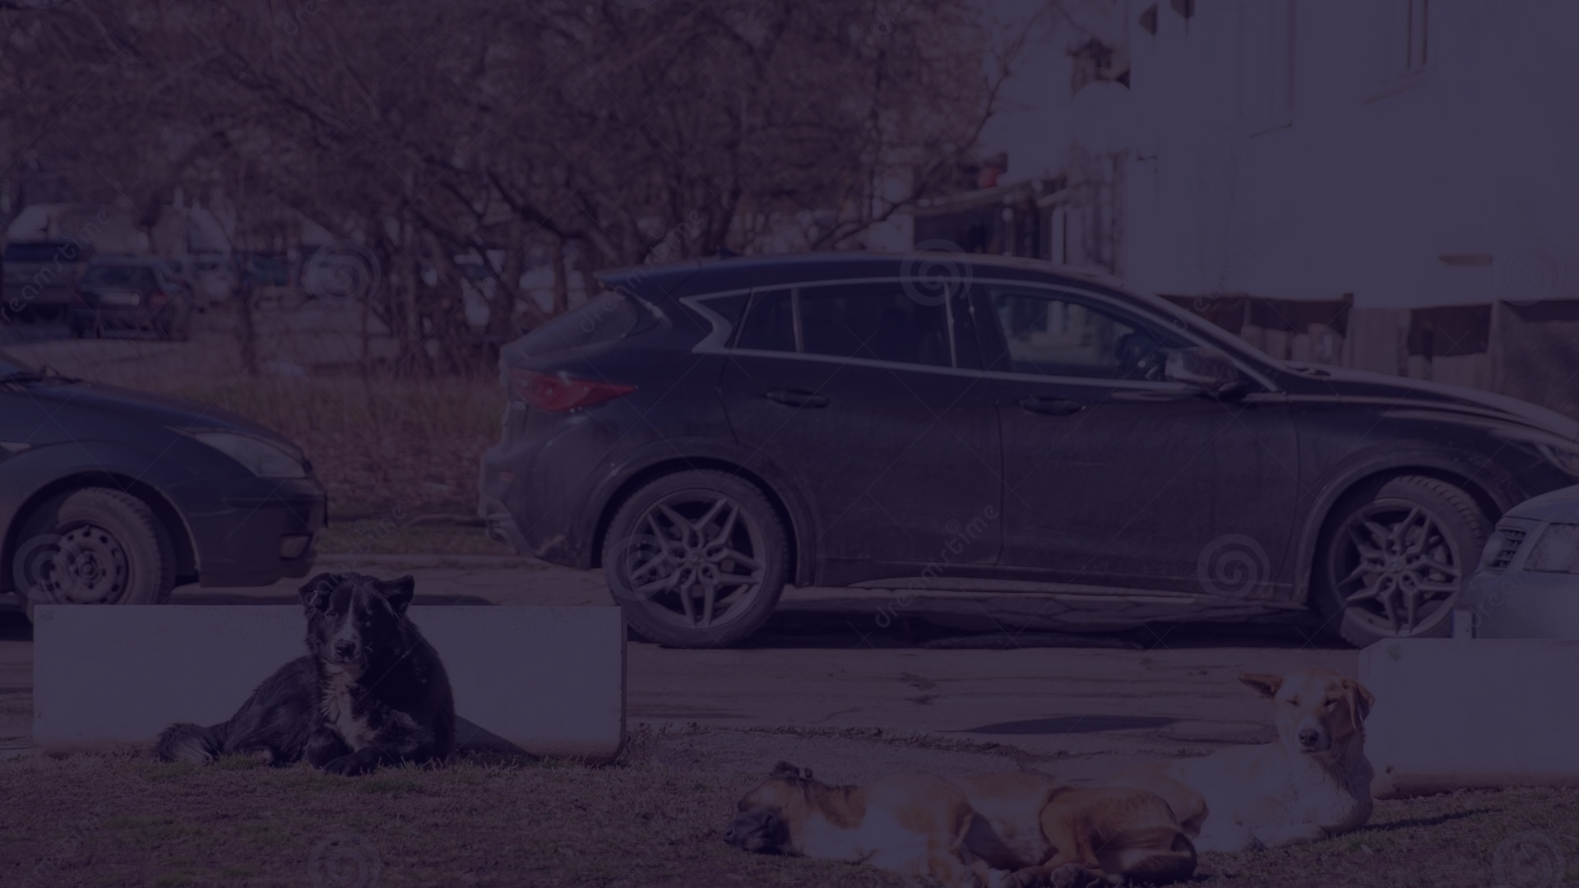
The Problem: Stray Animals on the Streets
1
Overpopulation
2
Safety Risks
3
Heartbreaking Fates
Stray and abandoned animals are an epidemic, leading to overcrowded shelters and countless pets without homes.
Stray animals face threats of disease, injury, and even euthanasia if they cannot be quickly rescued.
Too many loving pets end up living on the streets, suffering and struggling to survive.

Slide 3
BowWow's Mission: Connecting Stray Animals to Help
See a Stray
Find Nearby Help
Save a Life
Snap a photo of any animal in need and upload it to the BowWow website.
BowWow instantly locates the closest shelters, rescues, and volunteers who can respond.
The community rallies to provide food, medical care, and loving new homes.

Slide 4
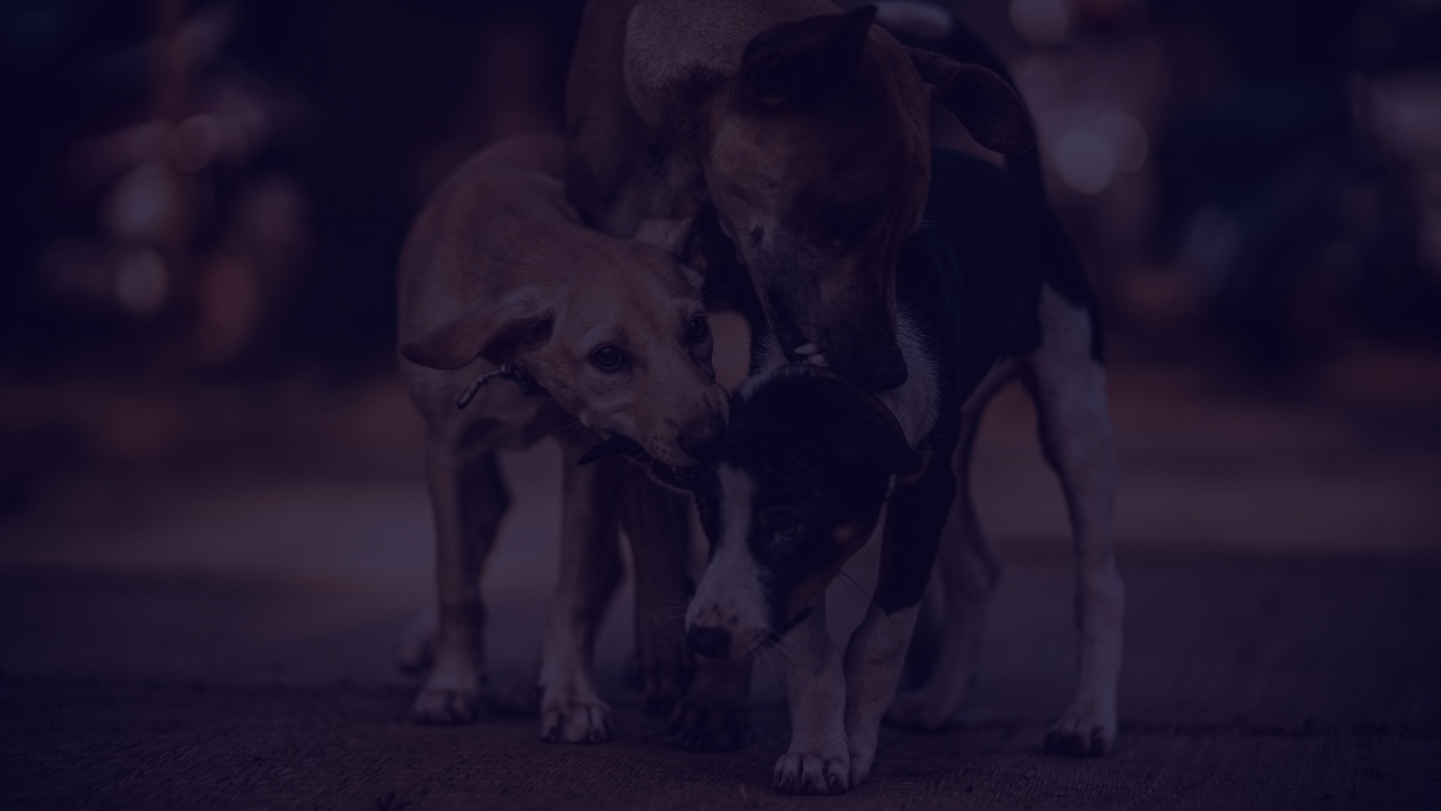
How BowWow Works: Upload Images, Find Nearest Help
Step 1
1
See a stray animal in need and snap a clear photo with your phone.
2
Step 2
Upload the image to the BowWow website or mobile app.
Step 3
3
BowWow instantly identifies the nearest shelters, rescues, and volunteers to help.

Slide 5
Benefits of Using BowWow
Save Lives
Build Community
BowWow connects stray animals with the resources and people to give them a second chance.
The platform empowers local volunteers and organizations to work together to help animals in need.
Prevent Suffering
Promote Adoption
By quickly locating help, BowWow reduces the time animals spend alone on the streets.
BowWow streamlines the process of finding loving, permanent homes for rescued pets.

Slide 6
Features of the BowWow Website
Photo Uploads
Location Mapping
Contact Information
Volunteer Portal
Easily submit photos of stray animals in need.
BowWow pinpoints the nearest resources based on your location.
Sign up to lend a hand and foster or transport rescued animals.
Get in touch with shelters, rescues, and volunteers to coordinate help.

Slide 7




Success Stories: Reuniting Pets with Loving Homes
Found
Rescued
Adopted
BowWow users spotted a scared stray dog and uploaded its photo.
A local shelter was alerted and quickly went to the dog's location.
The dog was nursed back to health and adopted by a caring family.

Slide 8

Get Involved: Volunteer or Donate to BowWow
Volunteer
Donate
Join your local BowWow team to foster, transport, or care for rescued animals.
Financial contributions help BowWow expand its reach and provide more resources to shelters.
Visit ../OneDrive/Desktop/doggiee/login.html to learn how you can make a difference in the lives of stray animals in your community.

